Slide 1
B.Tech – CSE – Sem. 3 18CSS201J – ANALOG AND DIGITAL ELECTRONICS (Regulations 2018)
UNIT 4
Session-13( Asynchronous Sequential Circuits Analysis and Problem Solving Session)

Slide 2
Asynchronous Sequential Circuits
Asynchronous sequential circuits basics
No clock signal is required
Internal states can change at any instant of time when there is a change in the input variables
Have better performance but hard to design due to timing problems
Why Asynchronous Circuits?
Accelerate the speed of the machine (no need to wait for the next clock pulse).
Simplify the circuit in the small independent gates.
Necessary when having multi circuits each having its own clock.
Analysis Procedure
The analysis consists of obtaining a table or a diagram that describes the sequence of internal states and outputs as a function of changes in the input variables.

Slide 3
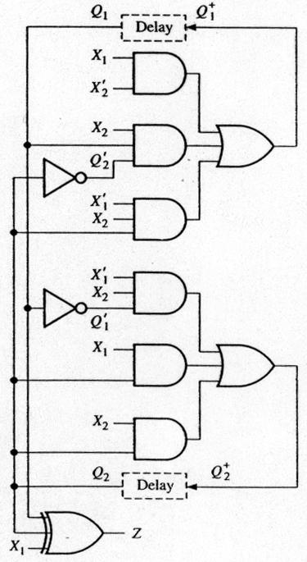
Example Circuit
Construction of Asynchronous Circuits:
using only gates
with feedback paths
Analysis:
Lump all of the delay associated with each feedback path into a “delay” box
Associate a state variable with each delay output
Construct the flow table
Network equations
Q₁⁺ = X₁X₂’+ X₁’X₂Q₂+X₂Q₁Q₂’
Q₂⁺ = X₁’X₂Q₁’+ X₁Q₂+ X₂Q₂
Z = X₁⊕Q₁⊕Q₂
Notes:
Concentra = Lump

Slide 4
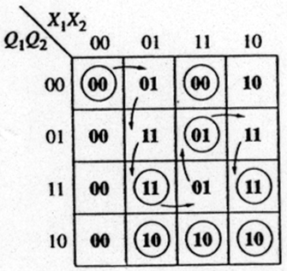
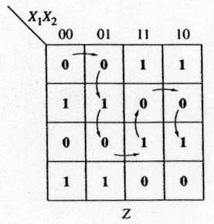


Example Circuit: Output Table
1.Starting in total state X₁X₂Q₁Q₂=0000
2.Input changes to 01
Internal state changes to 01 and then to 11.
3.Input changes to 11.
Go to unstable total state 1111 and then to 1101.
4.Input changes to 10.
Go to unstable total state 1001 and then to 1011.
The output sequence:
0 (0) (1) 0 (1) 0 (0) 1
Condensed to the form
0 (1) 0 (1) 0 1.
Two transient 1 outputs can be eliminated by proper design.

Slide 5
Transition Table
Transition table is useful to analyze an asynchronous circuit from the circuit diagram. Procedure to obtain transition table:
1. Determine all feedback loops in the circuits
2. Mark the input (y_{i}) and output (Y_{i}) of each feedback loop
3. Derive the Boolean functions of all Y’s
4. Plot each Y function in a map and combine all maps into one table (flow table)
5. Circle those values of Y in each square that are equal to the value of y in the same row

Slide 6
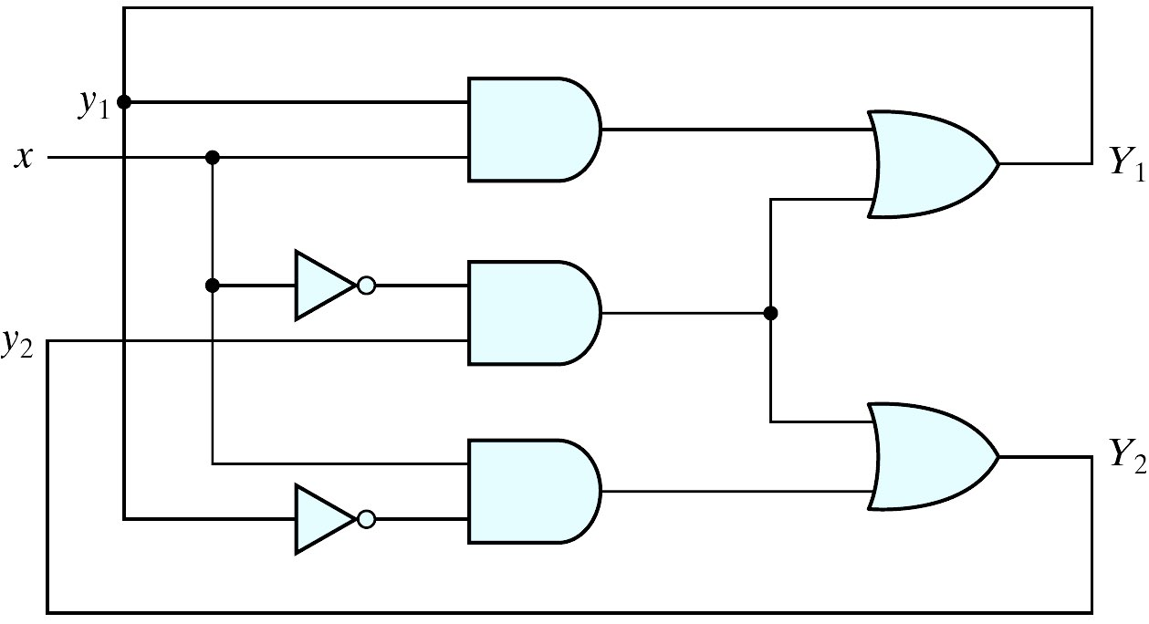
Asynchronous Sequential Circuit
The excitation variables: Y₁ and Y₂
Y₁ = xy₁+ xy₂
Y₂ = xy₁ + xy₂
CUT
CUT

Slide 7
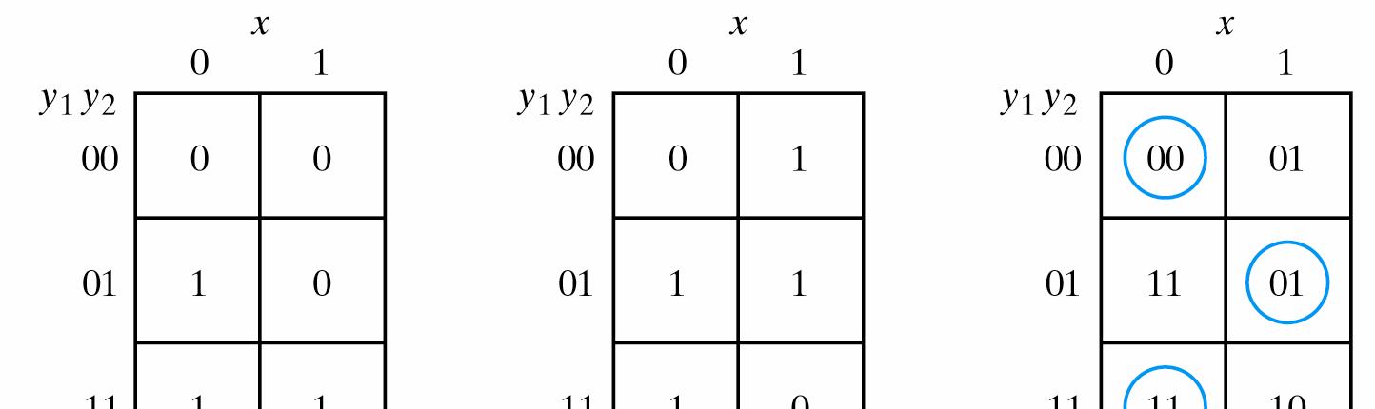
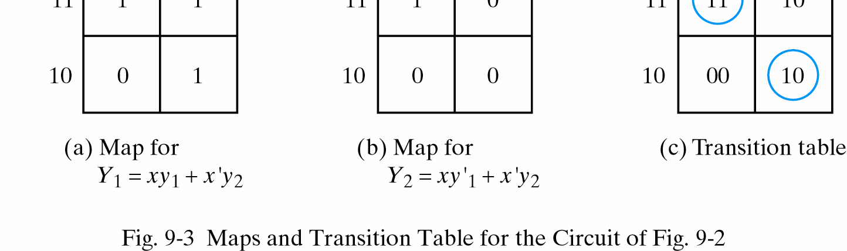
Transition Table
Combine the internal state with input variables
Stable total states:
y₁y₂x = 000, 011, 110 and 101

Slide 8
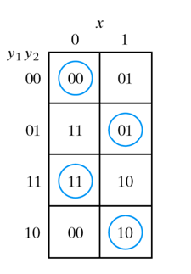
Transition Table
In an asynchronous sequential circuit, the internal state can change immediately after a change in the input.
It is sometimes convenient to combine the internal state with input value together and call it the Total State of the circuit. (Total state = Internal state + Inputs)
In the example , the circuit has
4 stable total states: (y₁y₂x= 000, 011, 110, and 101)
4 unstable total states: (y₁y₂x= 001, 010, 111, and 100)

Slide 9

Transition Table
If y=00 and x=0 Y=00 (Stable state)
If x changes from 0 to 1 while y=00, the circuit changes Y to 01 which is temporary unstable condition (Y≠y)
As soon as the signal propagates to make Y=01, the feedback path causes a change in y to 01. (transition form the first row to the second row)
If the input alternates between 0 and 1, the circuit will repeat the sequence of states

Slide 10
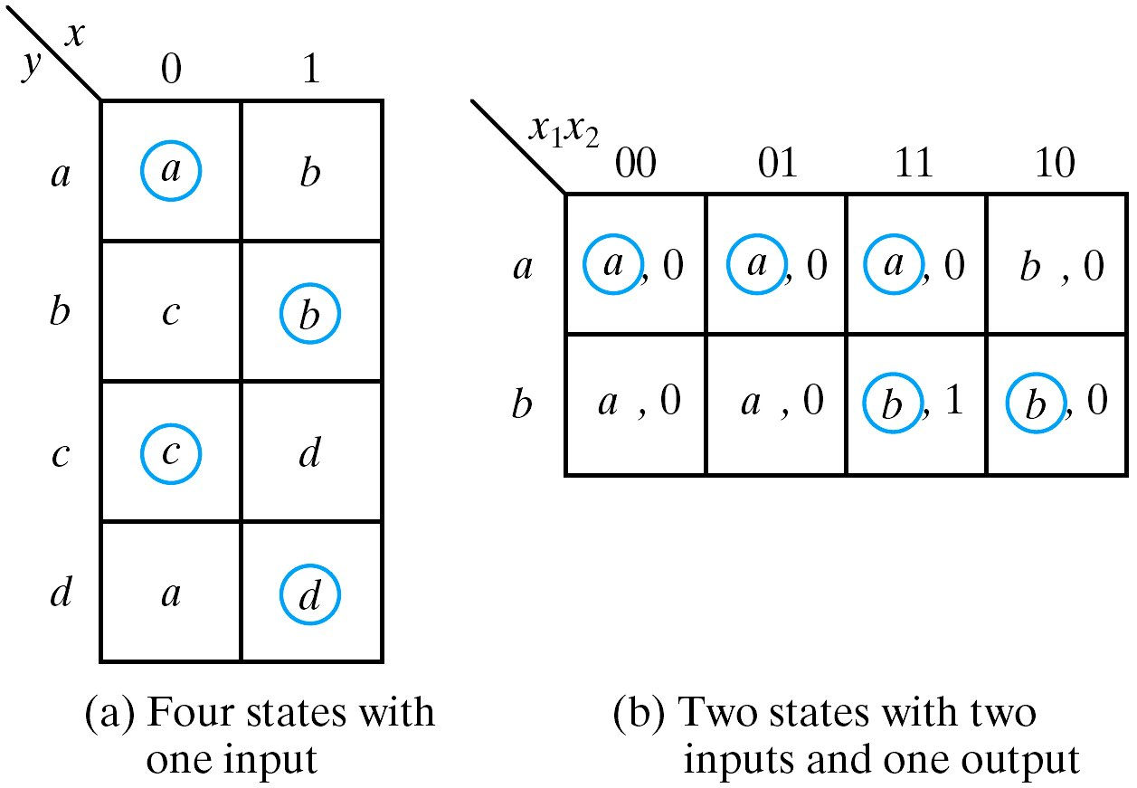
Flow Table
A flow table is similar to a transition table except that the internal state are symbolized with letters rather than binary numbers.
It also includes the output values of the circuit for each stable state.

Slide 11
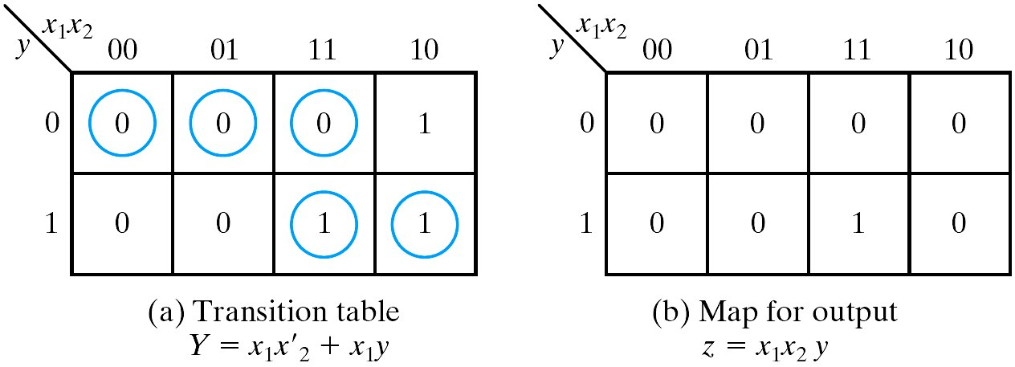
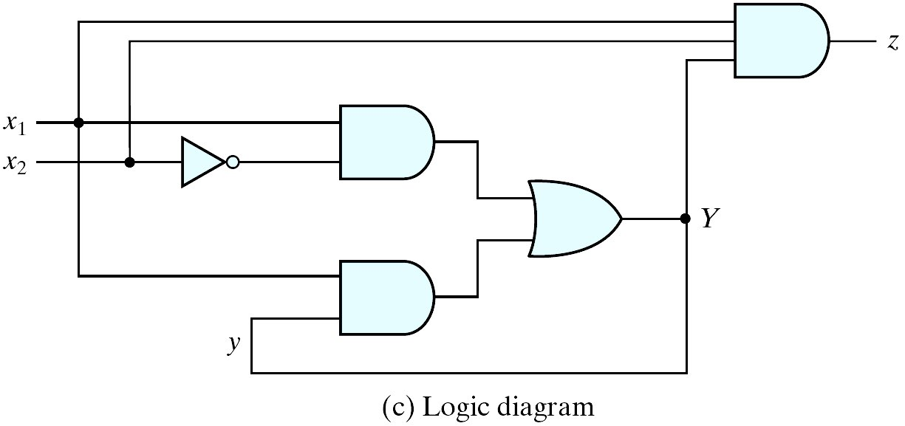
Flow Table
In order to obtain the circuit described by a flow table, it is necessary to convert the flow table into a transition table from which we can derive the logic diagram.
This can be done through the assignment of a distinct binary value to each state.

Slide 12
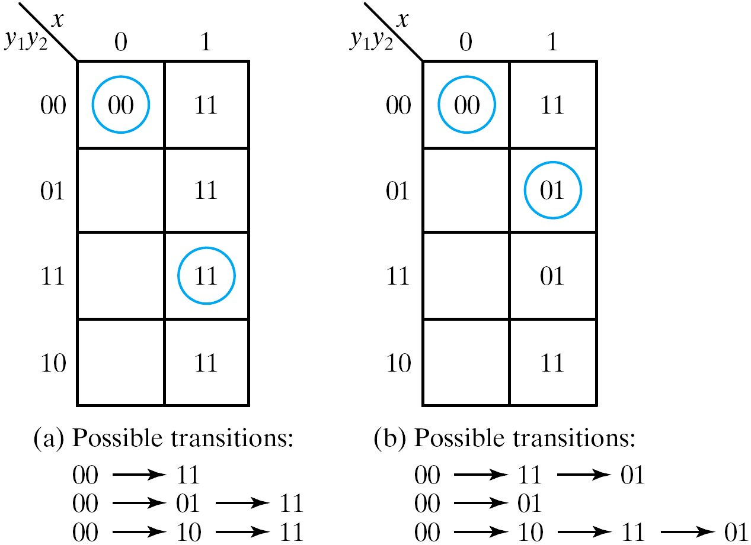
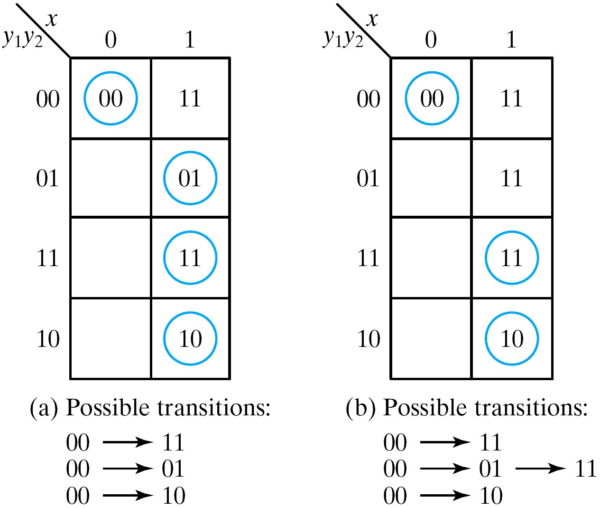
Race condition
Two or more binary state variables will change value when one input variable changes.
Cannot predict state sequence if unequal delay is encountered.
Non-critical race: The final stable state does not depend on the change order of state variables
Critical race: The change order of state variables will result in different stable states. Must be avoided !!

Slide 13
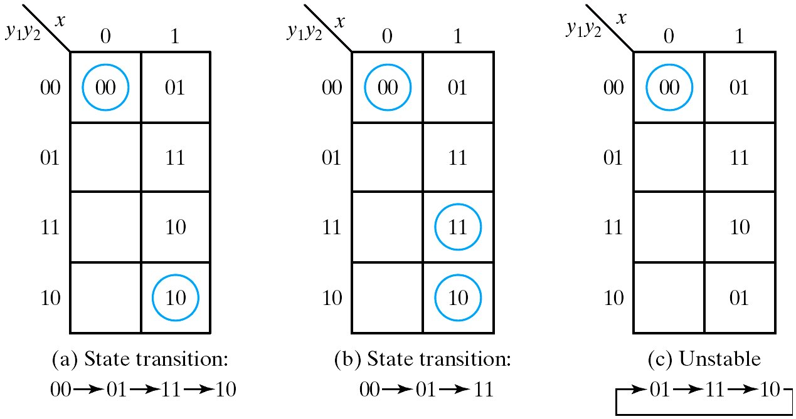
Race Solution
It can be solved by making a proper binary assignment to the state variables.
The state variables must be assigned binary numbers in such a way that only one state variable can change at any one time when a state transition occurs in the flow table.

Slide 14
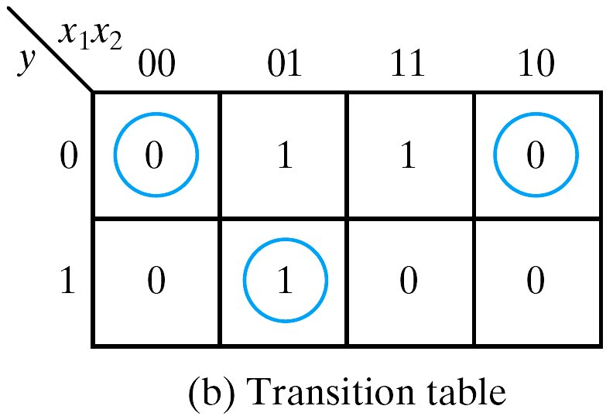
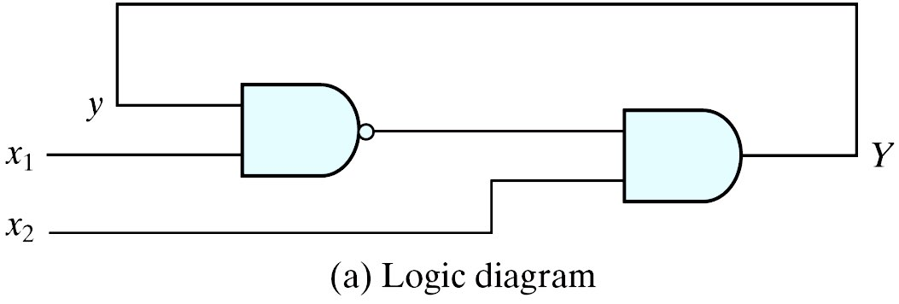
Stability Check
Asynchronous sequential circuits may oscillate between unstable states due to the feedback
Must check for stability to ensure proper operations
Can be easily checked from the transition table
Any column has no stable states unstable
Ex: when x₁x₂=11 in (b), Y and y are never the same
Y=x2(x1y)’=x’1x2+x2y’

